Slide 1


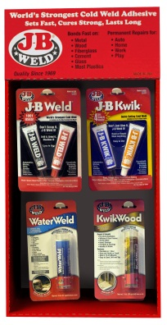
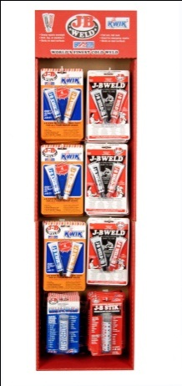
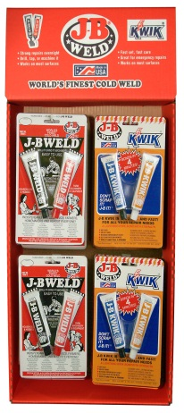
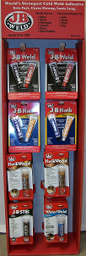
J-B Weld Displayers
“World’s finest cold weld compound”
J-B Weld Side Kick 24 pack Display – Mfr Part # 8202 10% Savings
24 unit display – 6 each of 8265, 8276, 8257, 8277
Great impulse sale!
Includes the fast-selling J-B KwikWood
REG DS Cost $75.64, Promo DS Cost $67.99
ORDER QTY:__________
J-B Floor 48 unit Display – Mfr Part # 8148 10% Savings
48 piece Floor Display – 18 each of 8265 and 8276, and 6 each of 8267 and 8277
Place in aisle for impulse sales.
Cross merchandise product in other departments
Ensure in stocks during peak selling season
Contains most popular J-B Weld products.
REG DS Cost $136.86, Promo DS Cost $123.17
ORDER QTY:__________
J-B Weld Sidekick Display – Mfr Part # 8201 10% Savings
Best sellers J-B Weld and J-B Kwik on a convenient display.
Display contains 12 each of 8265 and 8276.
Allows customers to grab one of each to cover all of their cold weld needs.
Great Impulse sale!
REG DS Cost $65.52, Promo DS Cost $58.97
ORDER QTY:___________
J-B Floor 48 unit Display – Mfr Part # 8149 Over 15% Savings
48 piece Floor Display – 12 each of 8265, 8276 & 8265, and 6 each of 8267 and 8277
Place in aisle for impulse sales.
Cross merchandise product in other departments
Ensure in stocks during peak selling season
Contains most popular J-B Weld products.
REG DS Cost $147.06, Promo DS Cost $125.36
ORDER QTY:__________
90 Days Dating. $125.00 Pre-paid freight.
Pricing valid through 6/17/11
Store #:__________ Store Name:___________________________________
Address:________________________________ City:____________________
State:_______ Zip:_____________ Phone:_____________________
Date:________ P.O.#:_____________ Contact:_____________________________
Please call Comprehensive Marketing 1-800-366-7512, or Fax 1-630-916-0735

